Slide 1
Polyglot Notebooks and .NET Interactive for Developers
Kathleen Dollard
.NET Languages and .NET Interactive PM, Microsoft

Slide 2
Literate Programming https://en.wikipedia.org/wiki/Literate_programming
Literate programming is a programming paradigm introduced in 1984 by Donald Knuth in which a computer program is given as an explanation of how it works in a natural language, such as English, interspersed (embedded) with snippets of macros and traditional source code…

Slide 3

Interactivity is not new
Smalltalk
DBase
Postman
SQL Server Management Studio
Kusto Explorer
IntelliSense
VBA (and earier – Lotus 123 macros)
Debuggers
Hot reload.
Terminals (interact with computer state)

Slide 4
Why interactivity?
One stop – fast feedback
Knowledge transfer
Execution location
Exploration
Building ideas

Slide 5
One stop shop
Check-in
Validate
Review
Measure
Evaluate
Improve
Code
Perf
Learn
Try
Explore
Edit
Run
Debug
Test
Build
Deploy
Repro
Fix
Report
Experiment
Test
Issues
Engineering (AI)

Slide 6

Knowledge transfer
Someone else has been there and can see above the clouds

Slide 7
Submission/kernel in Polyglot Notebook provides distributed processing
Submission
C#, F#, Python, R,
HTML, Mermaid,
PowerShell, JS,
KQL, SQL, HTML
More kernels easy:
AI engineering
MSBuild binlog
Message based:
Interceptable
Replayable
Idempotent
Multiple transports
Parallel/partion
Flexible compute location (Local or remote)
Formatter
Input
Output

Slide 8

Control execution location – Try .NET
Text
Try .NET service compiles
Compute resources controlled
User does not install .NET
WASM
Also…work can be moved around within the topology easily

Slide 9
Development
Starts with a clear idea of the solution
Design
Build
Test
Deploy
These are fairly discrete steps where it is reasonable to “go somewhere else” to take the next step
Exploration
Starts with a clear idea of the question
Ask
Visualize
Observe
Conclude
“Going somewhere else” for next step means deciding on next tool as well as next action

Slide 10
How do they differ?
Development
Exploration
Building a chicken coop, skyscraper, or application
What?
How do build it?
Do!
Role playing game with an unknown outcome
Debugging and profiling
AI engineering
Optimal retail website design
What?
How do we find the answer?

Slide 11
Consider performance of an implementation
Write
Profile
Visualize
Query
Choose
Modern IDE’s give you specific routes to evaluate, but when you need a more freeform evaluation, or just a different approach, multiple tools may be needed.

Slide 12
Interactivity is more than notebooks (and cells are not always best Ux)
Interactivity
Notebooks (Polyglot or Jupyter)
F# and C# Interactive windows in VS
Left/Right (HTTP Editor in VS)
Terminal-like (dotnet-repl)
.NET Interactive Engine

Slide 13
Implications
Polyglot interactivity lets you craft your own loops or be guided by experts
Consistent Ux across multiple tasks
Files interchangeable across Ux and targets

Slide 14

Interactive anatomy
Submission
Formatter
Input
Output

Slide 15
Interactive anatomy
Submission
Formatter
Input
Output
Submission
Formatter
Submission
Formatter
Input
Output
Input
Output
Submission
Formatter
Submission
Formatter
Input
Output
Input
Output

Slide 16
UI approaches to interactive
Notebooks (Visual Studio Code and Jupyter)
Terminal or REPL (dotnet-repl preview)
Left code/right results (HTTP editor)
In-editor code execution (future)
GitHub
Your app?

Slide 17
What is a “notebook”?
Formatted text as markdown along with code and results
Code can be run individually or as a group
Editor support allows coloration, IntelliSense, etc.
Results are displayed, usually in HTML
JavaScript support allows fancy output
Common file format can be opened in multiple tools

Slide 18
What is “Polyglot Notebooks”?
Visual Studio extension that is a provides a user experience (front end) for the .NET Interactive Engine
Embraces the Jupyter ecosystem
Same file format (.ipynb), visualizations, and [[kernels]]
Extends the Jupyter ecosystem
Additional file format (.dib)
Multiple languages in one notebook

Slide 19
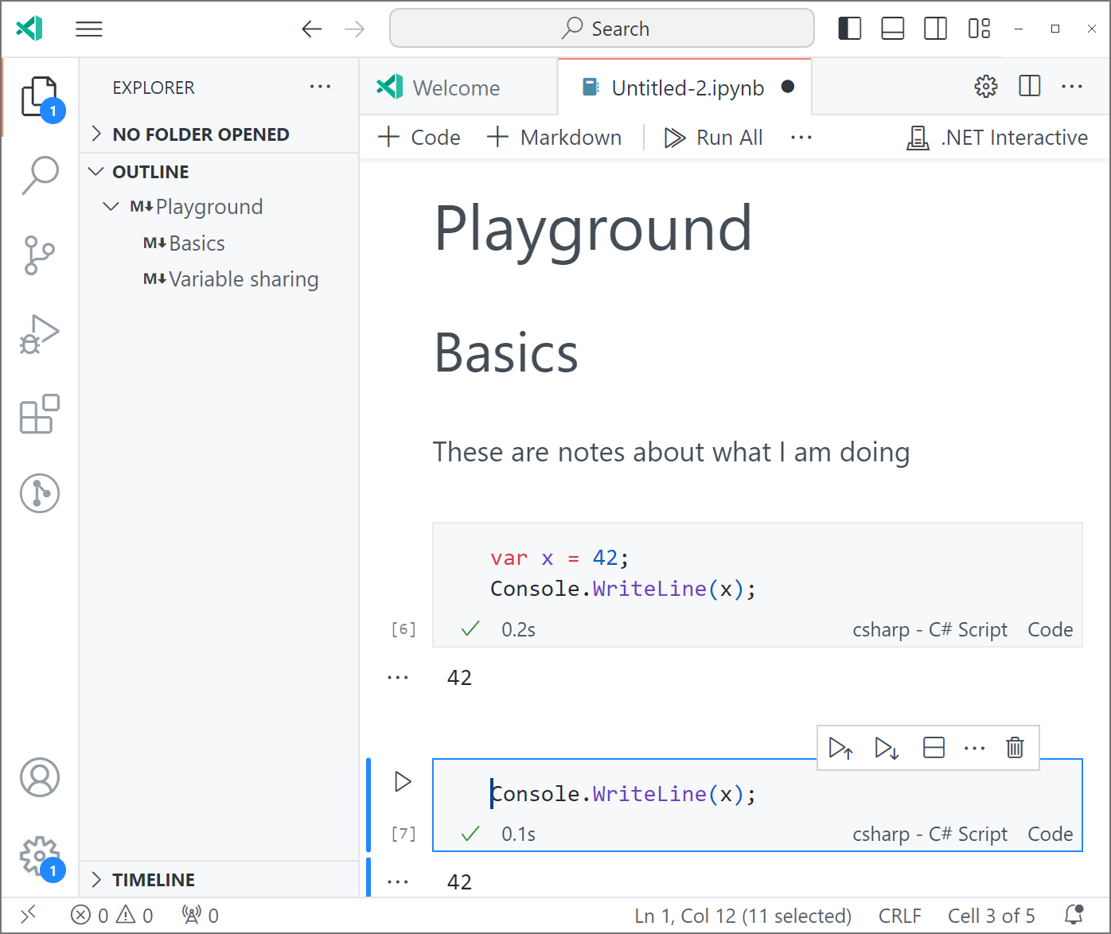

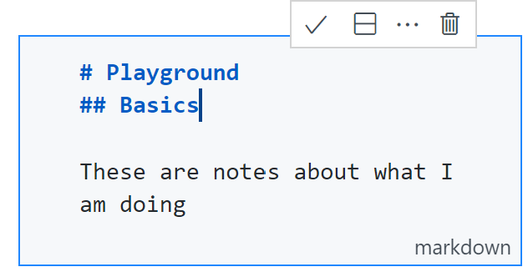
Layout of VS Code Notebooks
Notebook wide actions
Visual Studio Code
.NET Interactive/ Jupyter
Actions on markdown
Markdown outline
Edit pencil gives 
Code
Result
Type of cell
Actions on result
Actions on cell
Order last run

Slide 20
What is the “.NET Interactive Engine”
An engine communicating with kernels along with common protocols (API)
Kernels provide functionality directly or by calling services or other kernels
Language support is via kernels (also true in Jupyter)
Language support can be via interactive language versions or compiling
Polyglot Notebooks is one interface for .NET Interactive
Others include: MS Learn docs/Try .NET, the HTTP Editor in Visual Studio, and .NET REPL

Slide 21
What is a kernel?
A kernel is an execution engine for a notebook where the actual processing of the code takes place.
Kernels are UI-agnostic.
Kernels typically run in a different process from the UI and may run on a different machine.
In .NET Interactive, there may be several kernels within a single kernel process (subkernels).
.NET Interactive can act as a Jupyter kernel - A Jupyter kernel is any kernel that implements the Jupyter Message Protocol (JMP).

Slide 22
What can you do with .NET Interactive?
Explore a technique/domain
Learn from experts
Record your thinking
Run processes
Develop/record collaboration
See remainder of talk
Embed .NET Interactive in your applications
Create your own kernels
Create your own visualizations

Slide 23
Demo - Overview
Notebook is at https://github.com/KathleenDollard/sample-interactive

Slide 24
Showcase–DevOps Good walk through of PowerShell notebooks
Blog is at https://endjin.com/blog/2023/12/polyglot-notebooks-for-ops

Slide 25

Showcase–CPU diagnostic
Notebook is at https://github.com/dotnet/performance/tree/main/src/benchmarks/gc/GC.Infrastructure/Notebooks

Slide 26
Showcase–Learning Open AI AI lends itself to exploration Set of notebooks to teach and extend
Notebook is at https://github.com/azure-samples/openai

Slide 27
Demo – Let’s collaborate

Slide 28
.NET Interactive is a natural tool for developers

Slide 29
Please give us feedback  Issues in .NET Repo  Pings where you want interactivity

Slide 30

Resources
Basics
Slides: https:github.com/kathleendollard/DevIntersection2023
Samples: https:github.com/kathleendollard/samples-interactive
Polyglot Programming with Notebooks in Visual Studio Code in Microsoft Learn
Polyglot Notebooks - Visual Studio Marketplace
Polyglot Notebooks for Ops James Dawson, endjin (*****)
Revolutionizing Geospatial Analyses: Python and F# for Local Community Leaders Paweł Stadnicki
Azure-Samples/openai: The repository for all Azure OpenAI Samples complementing the OpenAI cookbook. (github.com) Microsoft
GC Team’s notebook for CPU evaluation
Learn how to create a weather forecaster.. Video using notebooks, Taylor Cowan
Blogs
Examples

